Slide 1
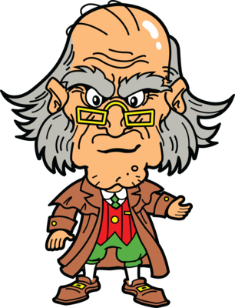
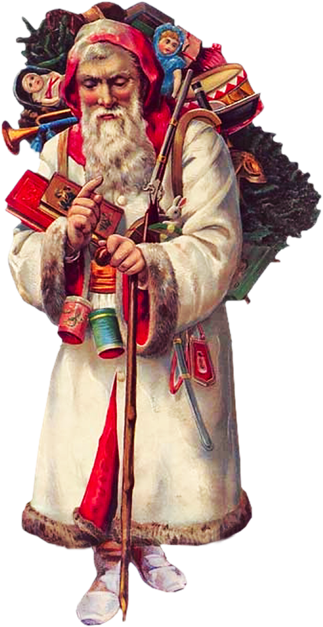
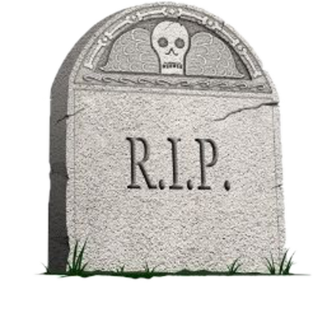
‘Marley was dead, to begin with.’
Scrooge and Bob are both working late on Christmas Eve.
Scrooge turns down Fred’s invitation, scorns the charity collectors and reluctantly gives Bob Christmas Day off.
Scrooge slowly makes his way home and sees Marley’s face in his door knocker.
Later that evening, Marley’s ghost appears.
Marley warns Scrooge that he must change his ways to avoid the same fate. He explains that he’ll be visited by three spirits.
The Ghost of Christmas Past appears.
Scrooge is taken to the village where he grew up and sees his younger self in school: alone at Christmas.
Scrooge then sees happier Christmases: his sister Fan coming to take him home and a party organised by his old boss, Fezziwig.
Scrooge is then shown his split from Belle, before being shown Belle’s family, who remind Scrooge of missed opportunities.
The Ghost of Christmas Present arrives.
Scrooge and the Ghost stop at the Cratchit’s house on Christmas Day. Scrooge learns Tiny Tim will die.
‘solitary as an oyster’
‘decrease the surplus population’
‘Darkness is cheap, and Scrooge liked it.’
‘I wear the chain I forged in life.’
‘Mankind was my business’
‘sprung a bright clear jet of light’
‘A solitary child, neglected by his friends…’
‘No more work tonight. Christmas Eve, Dick’
‘Another idol has displaced me’…’A golden one’
‘…an antique scabbard; but no sword was in it’
Scrooge and the Ghost see people all over the world enjoying Christmas, in spite of their isolation.
AO2: Technical analysis
‘If these shadows remain unaltered by the future, the child will die’
Although the basic narrative is in chronological order, the spirits are able to manipulate time to suggest their power. The continual references to time (running out) drives the plot and builds tension.
Similes are frequently used to lighten the mood. Whereas, metaphors are often used to darken it.
Dickens frequently uses symbols to represent larger ideas within the novella. A longer list can be found in the black box, but one of the most famous is the use of fire to symbolise the Christmas spirit. Scrooge’s ‘small fire’ in S1 represents his lack of Christmas spirit. By S5 Scrooge is telling Bob to buy another ‘coal scuttle’, representing his willingness to share his Christmas spirit with others.
AO1: Characters
Scrooge:
- Motivated by money
- He is cold hearted - His past shaped him - Has to see himself as others see him - Tiny Tim is his catalyst for change - Scrooge’s values change - His actions in S5 mirror those in S1 - His change is the story
Marley: - Represents what Scrooge would be - Punished by God - His appearance is disturbing - He is full of regret - He is now selfless
The Cratchits: - Poor but loving - B polite to Scrooge - B = devoted father -Mrs C good natured but busy - Tiny Tim is frail but doesn’t moan
Present: - Generously helps others - Compassionate, jolly and peaceful - Shows Xmas despite isolation - Sad about poverty
Dickens often darkens the mood to highlight his message about social responsibility: Marley, I&W, Joe’s shop.
They then visit Fred’s house. The guests at his party make fun of Scrooge and his attitude towards Christmas.
Is the happy ending foreshadowed by the fact that Scrooge’s mean father had a change of heart? Anything is possible.
‘A Merry Christmas and a Happy New Year to the old man, whatever he is’.
Much like a piece of drama, pay attention to the dialogue. Descriptions of the speaker’s manner and body language indicate their thoughts and feelings, as well as their choice of words. Compare the Cratchits before and after TT’s death.
The reader inherently trusts the omniscient narrator, due to their light-hearted, conversational, and occasionally sarcastic, tone. They encourage us to dislike Scrooge, initially, before making us sympathise with him by the end.
Dickens regularly makes use of contrasts to emphasise a set of ideas or values. Scrooge’s selfish nature, in Stave 1, is exacerbated by its juxtaposition with the selfless attitudes of Fred, Bob and the charity collectors, for example.
Fred: - He is Scrooge’s foil, due to their contrast - He’s very cheerful - Shows true Christmas Spirit -Warm and friendly
Past: - Memory and truth
Quiet but strong -Fan = Sorrow - Fezziwig = antithesis
-Belle = regret - S is reluctant
Yet to Come:
-Mysterious, silent and intimidating
- Scares Scrooge with the future - Pities Scrooge - Moment of change -Symbol of death?
Questions are also cleverly employed by Dickens. The narrator asks questions to engage the reader or leaves them unanswered to force them to reflect. Past uses questions to make Scrooge consider his emotions. Present uses them to force Scrooge to consider his attitude. Scrooge’s questions in S4 indicate his determination to change. Although they’re aimed at Scrooge, the spirits’ questions indirectly make the reader consider their own attitude.
‘They are Man’s… And they cling to me, appealing from their fathers.’
The Ghost reveals two starving children: Ignorance and Want. The ghost warns Scrooge to beware of them.
Repetition and hyperbolic lists help to exaggerate the atmosphere (often celebration). It can also act as to quicken the pace and add excitement.
Sensory language is used to bring a scene to life. Likewise personification brings life to abstract concepts (I&W) or settings.
Symbolism
The novella is allegorical, meaning it has a moral message hidden within it.
Marley’s chains symbolise his obsession with material wealth and money.
Ignorance and Want are the personification of society’s problems.
Past’s light represents truth from memories
Present’s scabbard symbolises peace on earth
Yet to Come’s shroud symbolises uncertainty
Fire and light represent emotional warmth
Music and dance symbolise happiness
The bed is a recurrent motif, which suggests the ghosts want to access Scrooge’s most private thoughts.
Weather reflects Scrooge’s character and emotions. Pathetic fallacy is often used by Dickens to set the tone.
‘You are about to show me shadows of the things that have not happened, but will happen in the time before us’
The Ghost of Christmas Yet to Come collects Scrooge.
AO3 : Context
Religion: Society was very religious, and many Victorians feared God’s punishment, for not abiding to the strict moral code: Marley’s penance would have frightened the upper class. In contrast, Dickens believed good Christians should be humble, charitable, faithful and selfless, rather than merely appearing religious. Christmas was becoming more secular and Dickens wanted to spread the message that charity, forgiveness and generosity should be all year round.
Poverty: John Malthus argued that poverty was inevitable and there wasn’t enough to go around. Dickens, in contrast believed that the rich just needed to be more generous. Initially, Scrooge represents the uncaring attitudes of Malthus et al., who wrongly (or so Dickens said) thought that charity encouraged poverty and advocated workhouses. Dickens knew about the plight of the poor, having grown up in poverty, and wanted to raise awareness; hence the sympathetic Cratchits.
Charity / Education: Industrial Revolution created a huge gap between rich and poor; however, it encouraged selfishness from the rich. Dickens believed in collective responsibility and Scrooge’s change echoes this. He also thought education could prevent crime, poverty and disease; Ignorance is a personified representation of this problem. Dickens hoped that the ever-positive Tiny Tim would draw sympathy from upper class readers for children and the issues they faced.
Society:
Industrial Revolution created jobs and drew large numbers of people together, which resulted in poor living conditions amongst the poor. The population grew (too?) rapidly and conditions worsened. Overcrowding, like the slums in S4, led to hunger, disease and crime. The slums were scary places for the rich, like Scrooge. Children suffered the worst (Tiny Tim / I&W) and it was very difficult to escape poverty. Dickens aimed to raise awareness for the poor: discouraging the rich’s ignorance.
Character sentence stems: - Scrooge, an obviously caricatural but unnervingly accurate depiction of the Victorian upper class, is… - Scrooge, who initially represented the notoriously selfish Victorian business owners, is… - The Cratchit family, a deliberately sympathetic portrayal of the Victorian poor, are… - Tiny Tim, whose frailty was indicative of the plight of the poorest children in Victorian cities, is… - Fred, whose positivity formed an ideal which Dickens wanted the wealthy to emulate, is…
AO1: Themes
The Ghost silently shows Scrooge the uncaring reaction of some people to an unknown man’s death.
Family: -Source of comfort - Full of happiness - Scrooge didn’t see the point, at first -Scrooge is isolated and alone to contrast the warmth of families - Scrooge finally embraces his chance for a family
Poverty: -Dickens exposes unfair treatment of poor - Wealthy must take responsibility - Cratchits = Victorian poor - Poverty can be seedy - Not as simple as rich and poor
Redemption: -The reality of the visions changes S - There are hints S will be redeemed - Scrooge’s changed behaviour leads to redemption - Scrooge isn’t forced to change - Transformed by learning empathy
Christmas: - Brings out the best in people - Involves generosity and kindness - Religious and secular side - Powerful enough to transform Scrooge -Message = all year
‘Old Scratch got his own at last, hey?’
‘Every person has a right to take care of themselves. He always did’
Scrooge sees a group of thieves trying to sell the dead man’s belongings, including the shirt from his corpse.
‘and to Tiny Tim…he was a second father’
‘and therefore I am about to raise your salary’
‘He was at home in five minutes. Nothing could be heartier.’
‘My dear Mr Scrooge, are you serious?’
‘I am as merry as a school-boy’
‘I will live in the Past, the Present, and the Future’
‘…read upon the stone of the neglected grave his own name…’
‘I am sure we shall none of us forget poor Tiny Tim.’
S1 = character flaws
S2/3/4 = lessons
S5 = completes the circular structure where mirrored events emphasise the change in Scrooge
‘And so, as Tiny Tim observed, God bless us, every one!’
We’re told that Tiny Tim will survive, and that Scrooge celebrates Christmas for the rest of his life.
The next day Scrooge gives Bob a pay rise.
He buys the Cratchits a huge turkey then joins Fred and his friends for Christmas dinner.
Scrooge has completely changed. He laughs, dances and wishes passers-by a Merry Christmas.
Scrooge finds himself back in his own bed on Christmas Day.
Scrooge promises the Ghost that he will honour Christmas and change the course of his life.
The Ghost takes Scrooge to a graveyard and points to a grave with Scrooge’s name on it.
Scrooge and the Ghost visit the Cratchits again. He’s upset to find out that Tiny Tim has died.
Scrooge is shown a corpse under a bed sheet and a woman rejoicing that her debt collector is dead

