Slide 1
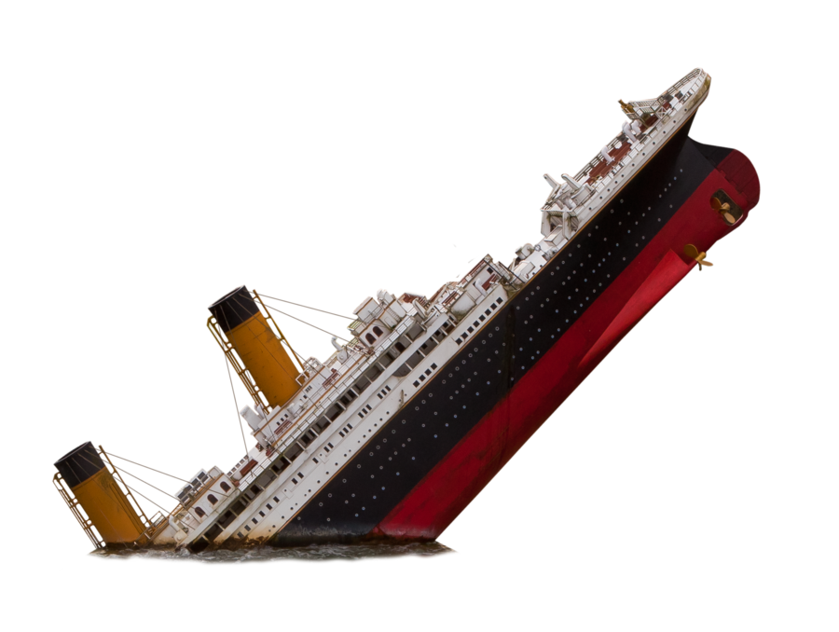
(It is an evening in spring, 1912.)
The Birling family are celebrating Sheila’s engagement to Gerald Croft. A celebratory mood is established.
Birling makes a lengthy speech, not only congratulating Gerald and Sheila, but also commenting on the state of the nation.
Arthur gives a speech to Eric and Gerald. He says that every man should look after himself.
Inspector Goole arrives and says that a woman called Eva Smith has committed suicide by drinking bleach.
The Inspector begins to question the family members, one by one.
It turns out that Arthur Birling sacked Eva from his factory, for striking in protest against low wages.
Birling accepts no responsibility and acts arrogantly. He then cools, when he finds out he might not be the only one involved.
It also transpires that Sheila asked for Eva to be sacked from Milwards, later that year, due to Sheila’s jealousy.
The Inspector explains that Eva then changed her name to Daisy Renton. Gerald appears shocked and Eric leaves.
Although he wanted to keep it a secret, Gerald confesses to keeping Daisy as his mistress last summer.
Gerald is upset. Mrs B attempts to defend him. Sheila returns his engagement ring and then he leaves.
‘working together – for lower costs and higher prices.’
‘I speak as a hard-headed practical man of business’
‘community and all that nonsense’
‘Yes, yes. Horrid business’
‘just keep quiet Eric, and don’t get excited’
‘better to ask for the earth than to take it’
‘How do you get on with our chief constable…?’
‘(she almost breaks down)’
‘(startled) what?’
‘Yes. We can keep it from him.’
The Inspector gets Sybil to confess that she persuaded her charity to reject Eva/Daisy’s appeal for help
1- isn’t a chance of war
1 – Girls of that class
AO2: Language, structure and form
‘As if a girl of that sort would ever refuse money!’
1 – A man has to make his own way
AO1: Characters
2 – I did nothing I’m ashamed of
Priestley’s choice to set the entire play in one room creates a claustrophobic and intense atmosphere. It emphasies the privacy and isolation of the upper class and hints at their close-minded nature.
When examining dialogue, look out for interruptions by other characters. This can be used to assert dominance.4
The Birling’s use of language makes it obvious that they are upper class characters. Likewise, it’s clear to see that Birling is obsessed with his status, through his use of language. Sheila’s language changes during the play to emphasise her growing maturity (‘mummy’ shifts to ‘mother’). The Inspector’s use of language is perhaps most interesting though. He’s concise, to the point and avoids any confusion. He abruptly interrupts the Birling’s status quo and asserts his own control. He also manipulates silence well.
1- community and all that nonsense
Mr Birling
-Pleased with life
-Ambitious capitalist - No responsibility -Wants control -Anxious underneath -Powerful language
Mrs Birling
-Proud of status
-Mr B’s ‘superior’
- Strict standards
- Superficial charity
- Doesn’t change - Has her mind made up throughout
2 – As if a girl of that sort would ever refuse money
Euphemisms make something seem better than what it is. Using euphemisms can represent denial, that someone is unwilling to accept the reality of a situation, or an attempt to hide things.
It transpires that Eva/Daisy was pregnant at the time, but Sybil places sole responsibility for her death on the father.
3 – I’d give thousands, thousands
2 – you’re behaving like a hysterical child
Sheila’s defiance and Eric’s drinking problem are foreshadowed from the beginning.
‘I blame the young man who was the father of the child she was going to have.’
3 – There’ll be a public scandal
3 – The rude way he spoke to Mr Birling and me. It was quite extraordinary
1 These girls aren’t cheap labour – they’re people
The ‘pink and intimate’ lighting, at the beginning of the play creates the impression that the Birling’s view the world as romanticised. The ‘brighter’ and ‘harder’ light, upon the Inspector’s arrival, means there’s no-where to hide.
Exits can indicate a character attempting to escape a situation: running away from reality. The Inspector manipulates the character entrances and exits, in order to shift the focus of his interrogation.
Dramatic irony is when an audience has more information or knows more than a character on the stage. It is often used as a tool to undermine Mr. Birling’s authority in Act One, which immediately presents him as a dislikable and ill-informed character.
2 – he’s giving us the rope so that we’ll hang ourselves
Sheila
- Different to family - Childish at first - More mature later -Moral standards -Changed by IG -Becomes like the Inspector
Eric
- Deeply troubled - Troubles are foreshadowed - Hiding something -Lacks self control -Consequences - Villain & victim?
1 – you’re squiffy
3 – as if she was an animal, a thing, not a person
2 I’m not a child, don’t forget
3 – you’re not the kind of father a chap could go to
The Birling’s costumes are obvious signals of wealth and set them apart from IG’s much plainer appearance. He has no need for superficial decoration.
The Inspector makes use of imagery to shock the reader or to assert his own control in a situation. His graphic descriptions of Eva’s death would shock an audience, as well as distressing Sheila. Additionally, the Inspector use religious imagery (especially in his final speech) to make himself seem more powerful. His God-like representation adds authority to his language.
Ensure that you review stage directions carefully. They give a clear insight into the thoughts and feelings of a character, which can often be lost in the quick interchanges between characters. The Inspector is a master of ‘cutting in’, which acts as to re-assert his authority. Sheila’s stage directions hint at her increasing maturity and Mrs. Birling’s at her unwillingness to change. The opening stage directions ate also worth reading carefully. SDs are just as important as any quote that you will analyse, so do not forget them!
‘(with sudden alarm) mother – stop – stop!’
Sheila guesses that the father of the child is Eric and begs her mother to stop making things worse for herself.
3 – you don’t seem to have learnt anything
3 – You don’t understand anything. You never did.
3 – If it didn’t end tragically, then that’s lucky for us. But it might have done.
3 – I can’t see it like that. The girl’s still dead, isn’t she?
Priestley builds tension through placing dramatic moments at the beginning and end of each act.
1 – you can drink to me
Gerald
- Eligible bachelor -Future Is bright -A natural Birling? -No regret?
- Thinks he’s innocent -Not just bad /good
The Inspector
- Goole / Ghoul? - Omniscient - Authoritative - Different world - Classless -Priestley’s mouthpiece?
1- better to ask for the earth than to take it
‘2 – fairy prince
2 – we’ll have to share our guilt
If a character pauses, it might indicate hesitation, suspicion, or nerves.
Eric returns. He knows that the Inspector has led everyone to the conclusion that he’s the father of the unborn child.
2 – we can keep it from him
3- We are members of one body
Priestley regularly builds tension through his pacing: IG slowly reveals information to assert his control, Gerald’s secret is delayed, and all of the character’s, despite being seated to begin with, end up standing and shouting.
‘absolutely unsinkable’
3 – What girl? There would probably four or five different girls
3 – millions of Eva Smiths and John Smiths
AO1: Themes
‘Besides, you’re not the type – you don’t get drunk’
3 – what about this ring?
Class - Defines characters - Clear structure - Class = everything? - Class shouldn’t matter? -Actions more important
Age
- Old = out-dated and out of touch - Young = different and responsible - Gerald = oldest young person - Age means nothing - Young can change
Gender - Heteronormative - Women = seen not heard - Men = power - Young women challenge this - Stereotypes broken by the end
3 – fire, blood and anguish
Consider the context (not specifically assessed)
Symbolism:
Eva Smith represented the entire of the working class. She’s voiceless and mistreated by upper class characters; this mirrors the power exerted over the proletariat (working class) by the bourgeoisie (upper class) , at the time.
The Inspector, with his omniscience, is arguably a symbol for God.
The titanic is symbolic of Mr Birling (and capitalism as a whole), as a once proud vessel is brought crashing down. Doors symbolise the entry and exits into Eva’s life. Sheila’s ring symbolises her growing maturity.
He describes how he met Eva at a bar, and drunkenly forced her to have sex. He stole money from Mr B to support Eva.
An
Inspector
Calls
In 1912, British society was firmly divided along class lines. Women were controlled by their husbands and the wealthy in Britain thought that life couldn’t get any better. After the wars, and consequent economic problems, life in Britain completely changed. In 1945, the year that WW2 ended and the play was released, society was almost unrecognisable from 1912. Although there was still a class divide, the boundaries had been obscured by the collective war effort and socialist ideas became much more popular. Right-wing ideas, such as private ownership and wealth, were increasingly viewed as out-dated, as greater social responsibility was widely encouraged by socialist political commentators, like Priestley himself.
In terms of family life, 1912 was much more heteronormative (strict roles for men and women). The Birling’s epitomise the ‘perfect’ 1912 upper class family , but it’s clear that something was not right. The clear hierarchy is destroyed by the Inspector, as Sheila and Eric begin to think for themselves. Their increasing independence represents the shifting attitude of the (then) younger generation. Their change symbolised the hope for a better society, which, in post-war 1945, was beginning to come to fruition.
‘You mean – you stole my money?’
Judgement - Morality play - 7 deadly sins - Omniscience / power of IG - Lesson at the end is most important - Young = moral
Life lessons - Some never learn - Arrogance of old prevents change - Young try to change - Ignorance was bliss - Sins all around
Responsibility
- Mr Birling – no - Mrs Birling – no - Gerald – no - Sheila / Eric – yes - Main focus of IG - Priestley promotes socialist ideas - Anti-capitalist
‘you’re not the kind of father a chap could go to when he’s in trouble’
Eva rejected the stolen money and turned to Sybil’s charity for help. Eric and Birling argue over the money.
And a police inspector is on his way here – to ask some – questions’.
‘…What? – here - ?’
‘the famous younger generation who know it all.’
‘Come on Sheila, don’t look like that. All over now’
‘The story’s just a lot of moonshine’
As Gerald says – we’ve been had’
‘fire, blood and anguish’
‘We are members of one body’
(As they stare guiltily and dumbfounded, the curtain falls)
A young woman has just been found dead, after drinking disinfectant. The police are sending an inspector to question the Birling family.
The phone rings. Birling answers and stands there in shock.
Eric and Sheila, clearly troubled, argue that they are still guilty of treating someone badly.
Birling, Sybil and Gerald all start to relax and make light of the whole situation.
Gerald calls the hospital and finds out that no-one has committed suicide.
Gerald returns, having spoken to a police officer, and says there’s no Inspector Goole. Birling confirms this by phoning Col. Roberts.
The Inspector warns that unless everyone learns to look after each other, the lesson will be learned with suffering. He then leaves.
The Inspector reminds the Birlings that we are all responsible for each other.
Eric says Sybil murdered her own grandchild by refusing to give Eva charity.

