Slide 1
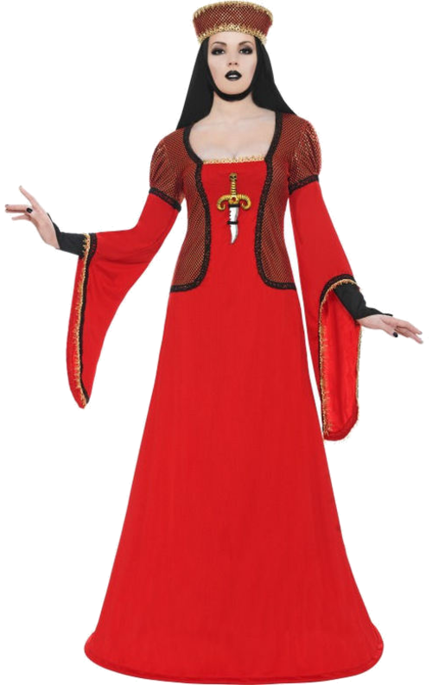
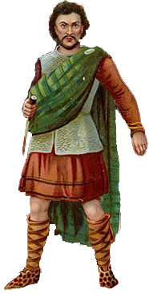
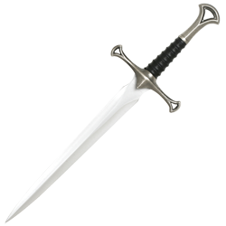
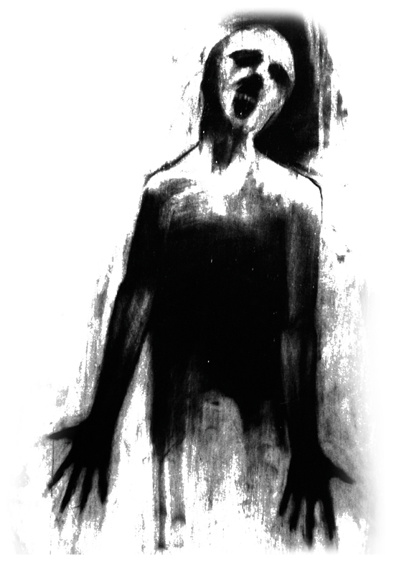
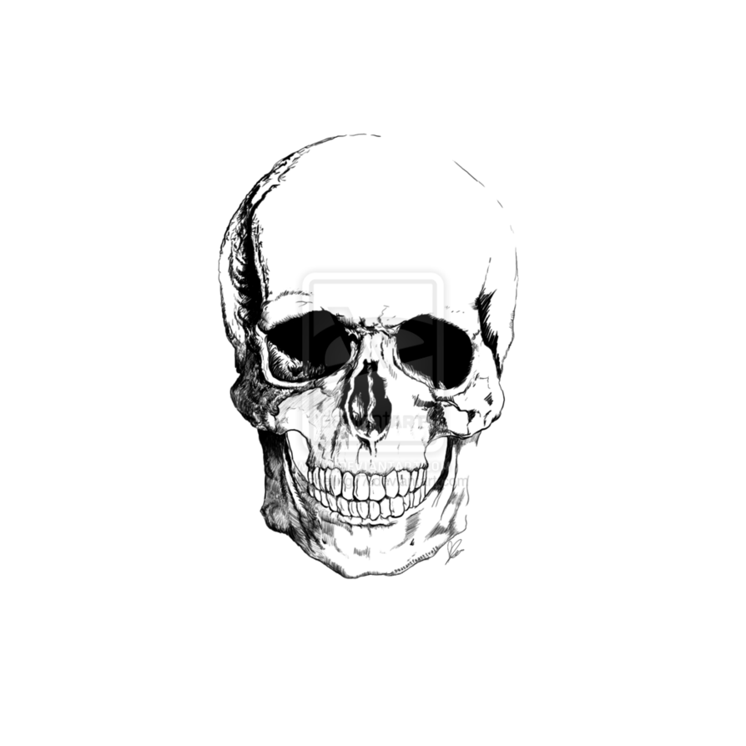
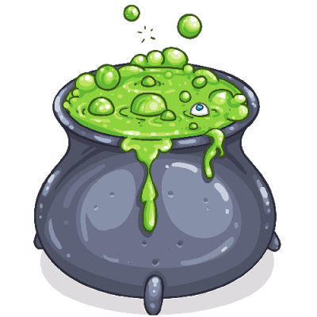
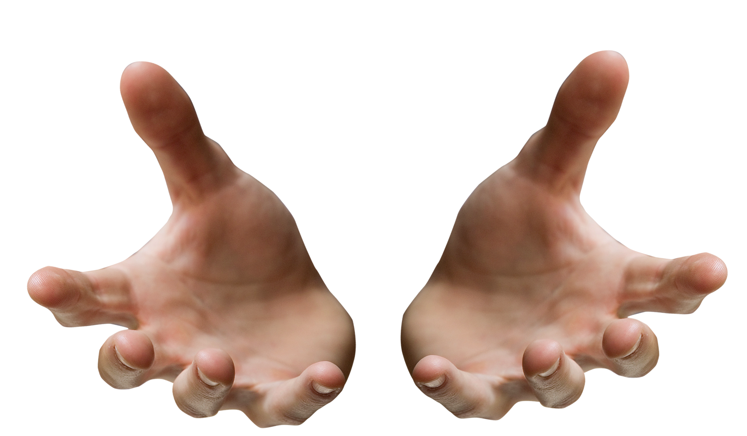
1:1 The Witches are introduced
1:2 Duncan talks about the battle
1:3 Macbeth meets the Witches who tell him he’ll be King.
1:4 Macbeth starts to think about killing Duncan.
1:5&6 Lady Macbeth learns of the Witches’ prophecy. Duncan arrives at Macbeth’s castle
1:7 Lady Macbeth persuades Macbeth to kill Duncan
AO2: Language, structure and form analysis
So foul and fair a day I have not seen 1:3
Characters
Unsex me here 1:5
2:1 Macbeth goes to kill Duncan
Metaphors are when one thing is said to be something else. Metaphors about nature are commonly used, especially ones about snakes.
Monosyllabic language is the use of one syllable words. It is often used to show extreme emotions, such as insanity, anger, grief or paranoia.
Exclamative sentences, or sentences ending in an exclamation mark (!), can be used to show extreme emotions, especially if they are used frequently in a short speech. Macduff’s immediate reaction to Duncan’s death, in 2:3, is a good example of excessive exclamatives representing overwhelming emotion.
art thou but a dagger of the mind 2:1
Look like the innocent flower, but be the serpent under’t 1:5
O, full of Scorpions is my mind, dear wife! 3:2
Macbeth
- Easily manipulated
- Fair but foul
- Corrupted by ambition
- Violent throughout
- Final downfall = hubris
Lady Macbeth
- Cruel, ambitious and ruthless
- Initially in control
- Weaker than she thinks?
- Insomniac
- Insane with guilt
dash’d the brains out 1:7
Similes are when one thing is like something else. Similes are often used as they imply that things don’t look or seem like they should.
Hyperboles are examples of excessive exaggeration. Duncan is prone to hyperbole, which hints at his naivety.
I am in blood stepp’d in so far …3:4
…but I shame to wear a heart so white 2:2
2:2 Lady Macbeth covers up the murder
Life’s but a walking shadow, a poor player… 5:5
Out, damned spot! out, I say! 5:1
Adjectives are describing words and can often indicate the attitude of one character about an another. Examples include: ‘brave’ Macbeth, ‘judicious’ Macduff, ‘gracious’ Duncan, and (ironically) the ‘honour’d’ Lady Macbeth.
A motif is a reoccurring idea in a text and often links different parts of a text together. Recurrent motifs in Macbeth include plants, birds and storms. These natural motifs are often used to imply that nature has been disturbed, and God is not happy.
Fair is foul, and foul is fair 1:1
Lesser than Macbeth, and greater 1:3
Personification is describing something as if it were a person. The earth is personified regularly to show that God is angered by Macbeth
You secret, black, and midnight hags! 4:1
The Witches
- Deliberately vague
- Instruments of fate
- Enjoy causing trouble and chaos
- Manipulate Macbeth’s ambition
- One entity?
Banquo
- Macbeth’s foil
- Macbeth obsessed by his prophecy
- Loyal and noble
- Terrifying ghost
- Sceptical of Witches & Macbeth
Loves for his own ends, not for you 3:5
I fear thou play’dst most foully for’t 3:1
2:3 Macduff finds Duncan’s body
Irony is found in a situation which is strange or interesting because it’s the opposite of expectations. There are plenty of interesting and subtle links between characters throughout. For example: LM telling M not to think about the murder of D, or else he’ll go mad, or the porter pretending to be the gatekeeper to Hell.
I conjure you…answer me to what I ask you 4:1
Our fears in Banquo stick deep 3:1
Foreshadowing is when the audience is given a clue about what is coming up later on. Macbeth is full of foreshadowing, albeit subtle. Examples include: Macbeth’s violence in 1:2 and Lady Macbeth’s isolation in 1:7.
Stage Directions direct the actors throughout the scenes. Often they can be used to infer a mood, such as celebration (hautboys) or tension (thunder). Thunder often accompanies the Witches and can be viewed as a pathetic fallacy, to indicate the trouble ahead..
Stay, you imperfect speakers, tell me more 1:3
Take any shape but that 3:4
blood-bolter’d Banquo smiles upon me 4:1
2:4 An old man talks about weird events. Macbeth is crowned King
I have begun to plant thee 1:4
Duncan
- Macbeth’s antithesis as King
- Popular and fair
- Emotional
- Far too trusting
- His sons are good men
The Macduffs
- Macbeth’s antithesis as a man
- Wife contrasts LM
- Country > family
- Loyal and strong
- Sirrah’s death = ruthless Macbeth
The repetition, in a woman’s ear, would murder as it fell 2:3
whom I built absolute trust 1:4
Juxtaposition is where two ideas are contrasted in the same scene or situation. Macbeth is full of contrasts, including the juxtaposition of Macbeth and Banquo’s reactions to the Witches.
That summons thee to heaven or to hell 2:1
No, cousin, I’ll to Fife 2:4
Imperatives command someone to do something. Lady Macbeth’s language is full of imperatives as she takes control at the start.
Entrances and exits on the stage are also worth noting. They can sometimes emphasise certain ideas, such as Lady Macbeth’s isolation as she enters the stage alone, to face Duncan and his attendants in 1:6.
broke ope The Lord’s anointed temple 2:3
…to do harm is often laudable 4:2 (LM)
But I must also feel it as a man 4:3
3:1-3 Macbeth realises that Banquo’s a threat so has him killed
A paradox is a statement which contradicts itself. The whole play is based on the paradox of ‘fair is foul, and foul is fair’, as everything is not as it seems.
When examining dialogue, look out for interruptions by other characters. This can be used to assert dominance.
After life’s fitful fever he sleeps well 3:2
…from his mother’s womb untimely ripped 5:8
Soliloquies are speeches by characters when they are either alone on the stage or when no-one else can hear them. Effectively, an audience is able to find out exactly what that character is truly feeling.
Symbolism:
Light = good
Dark = evil
Nature = correct order
Health / disease = state of Scotland
Blood = guilt
Water = innocence Masculinity = aggression / courage
Blank verse:
- Used by majority of characters
- Lines don’t usually rhyme
- 10 or 11 syllables per line
- Typically iambic pentameter - Regular rhythm of the lines = characters sound well spoken
Themes
Rhetorical questions, or questions that do not require answers, can indicate power in conversations. Lady Macbeth frequently uses them in 1:7 to assert her authority over her husband.
Supernatural
- Witches are deliberately confusing
- Vision of dagger
- B’s ghost = guilt
- Apparitions and prophecies
- LM’s bloody hands
Fate vs Free Will
- M’s choices?
- M doomed from the start?
- M believes his fate - B doesn’t act on prophecy
- M loses control of life
Reality vs appearance
- ‘Fair is foul’
- Hiding true thoughts
- Harder to hide (LM)
- Too trusting of appearances? (D)
- Audience see ‘true’ characters
Euphony is an overwhelming use of pleasing sounds and words. Macbeth and his castle are initially presented as being overwhelmingly positive by Duncan; an ironic misinterpretation.
3:4 Macbeth sees Banquo’s ghost
Asides are sections of speech where characters speak only to themselves (and the audience), and can reveal their true thoughts and feelings. Macbeth begins to plot against Duncan in an aside in 1:4.
Cacophony is an excessive use of harsh sounds and words. The Witches’ speech is sometimes jarring and unpleasant, to emphasise how evil they are.
Repetition, when an idea or quote is repeated, can be used to indicate power, or suggest confusion. Repeated questions, such as Macbeth in 1:3, imply weakness, as he doesn't’t have the answers.
Prose
- Lower class characters use prose
- Speech sounds more natural with no set rhythm
- Porter speaks in prose
- Lady Macbeth speaks in prose when she sleepwalks = insanity.
Sentence lengths and punctuation can give a good indication of the emotions of a character. Upon hearing about Duncan’s death in 2:3, most characters use short sentences to show their shock (even LM manages to). Macbeth, meanwhile uses longer sentences, which hints that he is not surprised by the death. Also, by disrupting the rhythm of the blank verse, Shakespeare can further emphasise emotions.
Ambition
- Motivates M & LM
- M’s fatal flaw
- Corrupts M & LM
- Macduff ambitious for Scotland
- Banquo doesn’t act on ambition
Good vs Evil
- M initially good
- Women = evil?
- Constant battle
- M overcome by evil desires
- Religious conflict (Heaven and Hell)
Loyalty/Betrayal
- B & Macduff loyal
- M & LM pretend to be loyal
- Loyalty to Scotland
- Betraying God
- Macbeth doesn’t earn loyalty as King
Sibilance is an alliterated ‘S’ sound. It can resemble the hissing of a snake and can often be found in speeches by M and LM.
Dramatic irony is when an audience has more information or knows more than a character on the stage. It is frequently used to build tension, especially at the start where the audience know Macbeth’s plan to kill Duncan yet they helplessly watch Duncan walk to his death in 1:6.
Rhyme
- Sets the witches apart as evil and unnatural - Witches use trochaic tetrameter -Sometimes rhyme is used for emphasis by other characters
3:5 Hecate plans to ruin Macbeth
Euphemisms make something seem better than what it is. Using euphemisms can represent denial, or that someone is unwilling to accept the reality of a situation.
The play has a cyclical structure. Macbeth begins and ends in battle (ironically with a beheading too).
5:9 Malcolm becomes King
5:8 Macduff kills Macbeth
5:5&7 Lady Macbeth kills herself and Macbeth kills young Siward.
5:2-4&6 The English army advances, disguised as Birnam Wood
5:1 Lady Macbeth sleepwalks
4:2&3 Macbeth has Macduff’s wife and son killed. Malcolm tests Macduff and Macduff learns of the murders
4:1 Macbeth visits the Witches, and is shown three apparitions that predict his future
3:6 Lennox is told of a plot to overthrow Macbeth

